Slide 1

Speech Emotion Recognition with librosa Python
Team members: 2010030087 pavan vikhyath
2010030358 Venkatesh
2010030364 yashwanth
2010030520 karthik
GUIDED BY:
SREELAKSHMI MAM

Slide 2
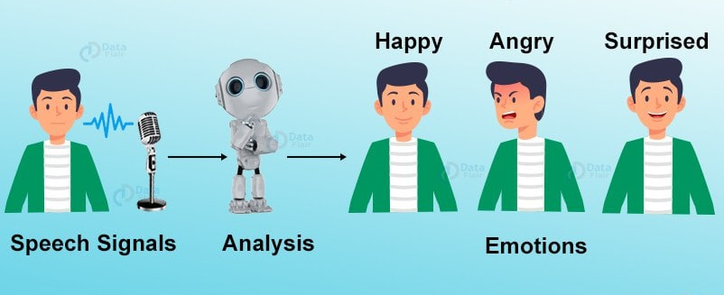
CONTENTS :
Abstract
Introduction
Literature review
System specifications
Tools setup
Datasets
Methods
Results
Github-setup
Discussion
Conclusion

Slide 3
ABSTRACT :
Speech emotion recognition is a trending research topic these days, with its main motive to improve the human-machine interaction. At present, most of the work in this area utilizes extraction of discriminatory features for the purpose of classification of emotions into various categories. Most of the present work involves the utterance of words which is used for lexical analysis for emotion recognition. In our project, a technique is utilized for classifying emotions into Angry', 'Calm', 'Fearful', 'Happy', and 'Sad' categories.

Slide 4
INTRODUCTION :
Speech emotion recognition is a technology that extracts emotion features from computer speech signals, compares them, and analyzes the feature parameters and the obtained emotion changes. Recognizing emotions from audio signals requires feature extraction and classifier training. ➢ The feature vector is composed of audio signal elements that characterize the specific characteristics of the speaker (such as pitch, volume, energy), which is essential for training the classifier model to accurately recognize specific emotions. Librosa is a Python package for music and audio analysis. Librosa is basically used when we work with audio data like in music generation(using LSTM's), Automatic Speech Recognition. It provides the building blocks necessary to create the music information retrieval systems

Slide 5
Literature review
1.Speech Emotion Recognition with librosa
AUTHORS : Saikat Basu, Jaybrata Chakraborty , Arnab Bag and Md. Aftabudd
we have presented a database for the analysis of spontaneous emotions. The database contains physiological signals of 32 participants, where each participant watched and rated their emotional response Implementation of emotional speech database depends on objective of the research. For efficient affect detection system,it is important that the corpora must consists of real and natural emotional speech spoken by a large number of male and female persons
REFRENCE LINK: https://data-flair.training/blogs/python-mini-project-speech-emotion-recognition/
https://www.irjet.net/archives/V8/i7/IRJET-V8I7494.pdf

Slide 6
SYSTEM SPECIFICATIONS:
HARDWARE:
Processor : CORE i3
Hard disk : 250GB
RAM : 8 GB
SOFTWARE:
Operating system : WINDOWS 10
Programming language : PYTHON 3.8.6

Slide 7
Tool setup
Programming language : python
Tools : jupyterlab,pycharm
Libraries: librosa and sklearn libraries

Slide 8
datasets
These are the two datasets
1.IEMOCAP
2.RAVDESS

Slide 9
IEMOCAP (The Interactive Emotional Dyadic Motion Capture
Multimodal Emotion Recognition IEMOCAP The IEMOCAP dataset consists of 151 videos of recorded dialogues, with 2 speakers per session for a total of 302 videos across the dataset. Each segment is annotated for the presence of 9 emotions (angry, excited, fear, sad, surprised, frustrated, happy, disappointed and neutral) as well as valence, arousal and dominance. The dataset is recorded across 5 sessions with 5 pairs of speakers.

Slide 10
RAVDESS (Ryerson Audio-Visual Database of Emotional Speech and Song)
The Ryerson Audio-Visual Database of Emotional Speech and Song (RAVDESS) contains 7,356 files (total size: 24.8 GB). The database contains 24 professional actors (12 female, 12 male), vocalizing two lexically-matched statements in a neutral North American accent. Speech includes calm, happy, sad, angry, fearful, surprise, and disgust expressions, and song contains calm, happy, sad, angry, and fearful emotions.

Slide 11
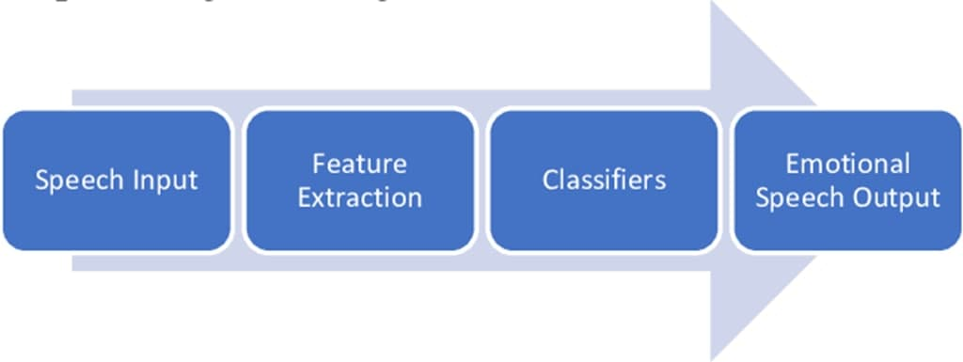
methods
The application we are trying to make takes speech input using microphone.as programmed by the programmer, the application recognizes the emotion in the sound as the emotions were classified before. When it recognizes which emotion the sound belongs to it gives the respective output

Slide 12
results
this project helps in understanding human emotions without the help of a person
there are few thing in about the project
-> hospitals to understand patients emotion
-> companies if the employee can cope up with the work
-> custemer service to understand custoemers' review
-> education to understand student emotion
-> analyze the music using the tone
-> in zoo to predict animals emotion

Slide 13
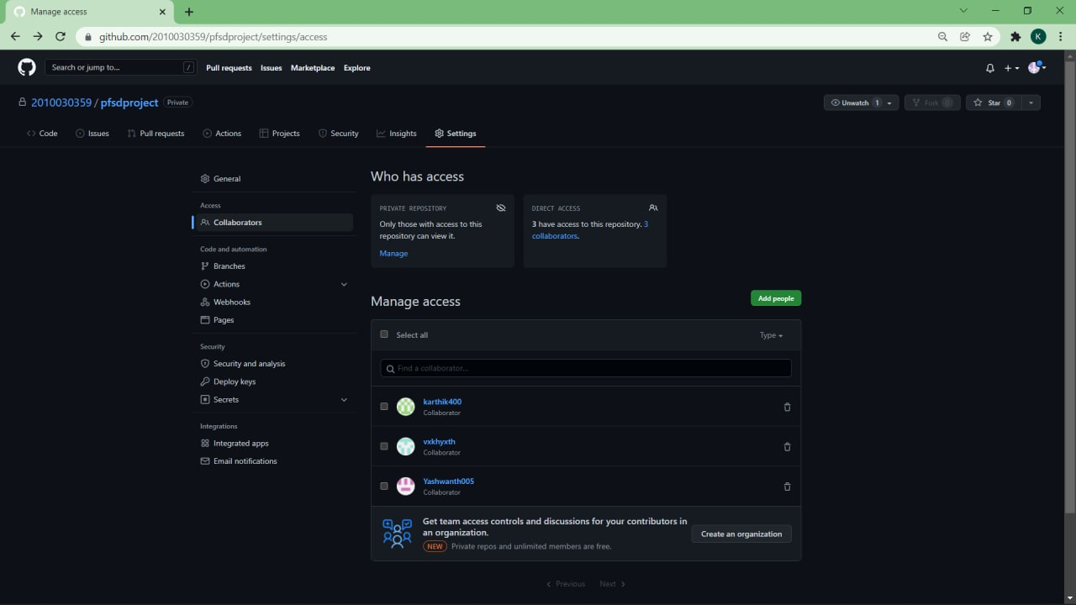
GITHUB-SETUP

Slide 14
discussion
we used multi layer perceptron classifier and rayerson audio visual database
of emotional speech and song database as it gives the accurate results.
it take the help of the library of libson to read audio files in python.
this project will be helpful in education, coustomer service, hospitals etc.The prediction of
emotion is done by taking the audio data from the microphone and preprocessing
it i.e., extracting its features and feeding it to the model.The model will predict
the emotion output.

Slide 15
Conclusion :
Thus we conclude This speech based emotion recognition can be used in understanding the opinions/ sentiments they express regarding a product or a political opinion etc.. by giving the audio as the input to this model.

